Slide 1

GitHub tutorial pre-launch and Q&A
Yi Yu
Precision Agriculture, Hydrology, and Geoinformation Science Lab (PAHGISL)
The University of Sydney
25 Nov 2025

Slide 2
In what cases GitHub would be useful for ag researchers?
Version control & archive
Can you remember what you wrote three years ago?
Did you have any circumstance that you need to re-use your code written a while ago?
Community trust
When we say “community”, it is about a global, non-for-profit, and scientific community; similar to how peer-review functions
Work as an organisation
Establish the “brand” (imagine this as a startup?)
In general, you don’t have to use GitHub—but if you want to make your research more impactful & reproducible, it could be something.

Slide 3
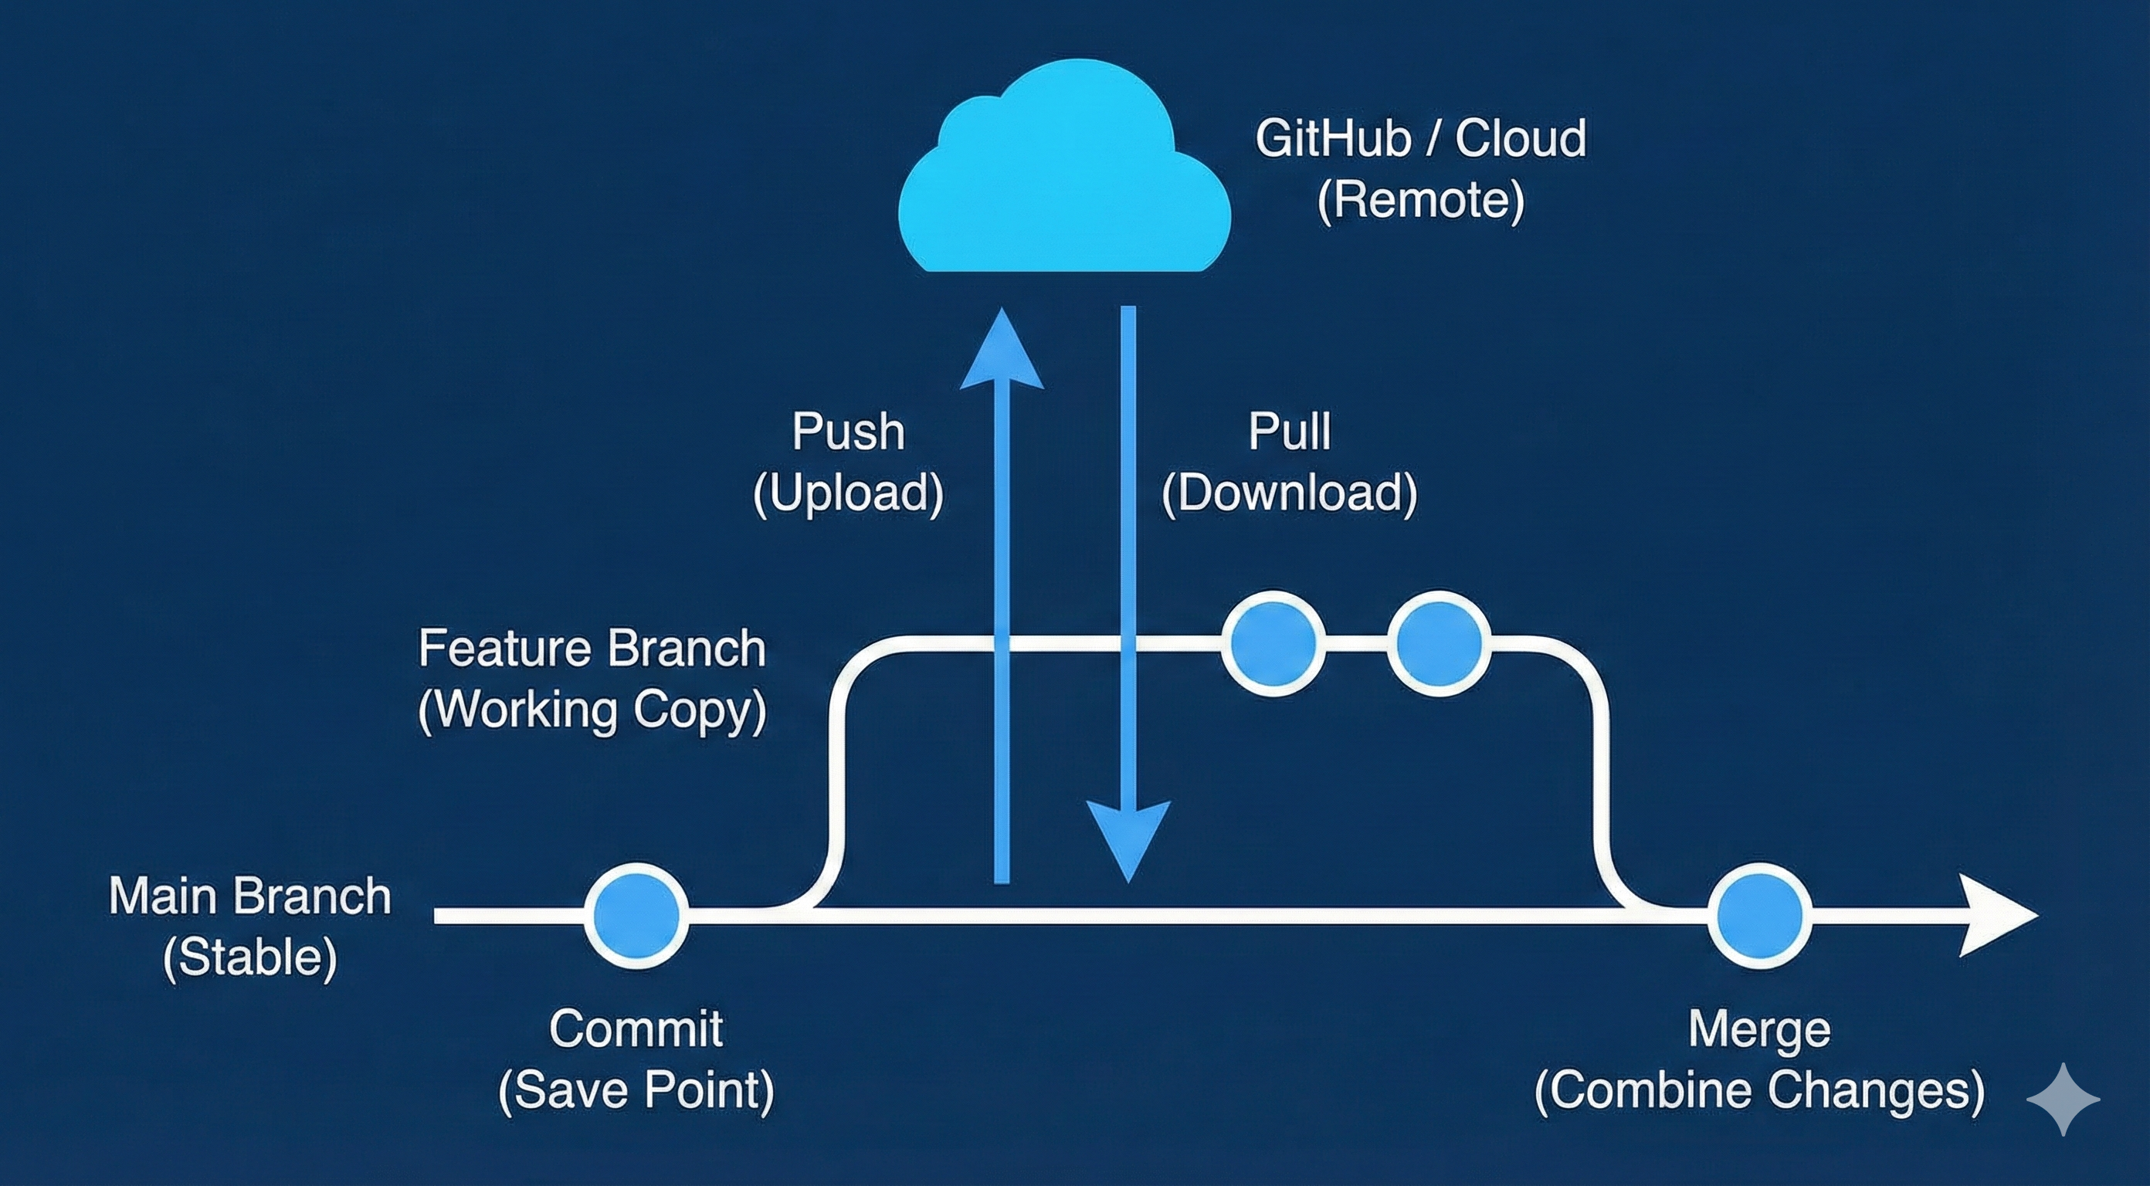
How we can code as a team through GitHub

Slide 4
We will be doing live coding!
Please launch your VS Code now.

Slide 5
Q&A: Lab GitHub Discussion
See `FAQ.md`.

Slide 6
Conclusions
Again, you don’t have to use GitHub (work is just work!)
In my view, if you have more enthusiasm of science than just “finishing the work”
GitHub could be a bonus—to get you more exposure & to communicate with the broader scientific community
Even if so, don’t wait until the code is perfect. Start with a private repo / or a repo share between colleagues. Polishing can always be done when you are ready to publish it to the public, but working on some established things is better than working on nothing.

